Slide 1
Introduction to Mortgage Lending
Presented By: Jinesh Paul

Slide 2
Agenda
What is Mortgage
Mortgage Lending Activities
Industry Partners
Underwriting Agencies
Types of Mortgages
Loan Amortization
Loan Purpose
A LOOK AT THE UNIFORM RESIDENTIAL LOAN APPLICATION A.K.A. FORM 1003
Mortgage Maths
Ratios in Mortgage
Supporting Documentation
Summary

Slide 3
Fun Fact !
The term “mort” is derived from the French word “dead” and “gage” is derived from the English word “pledge”.

Slide 4
What is Mortgage
A mortgage is a long-term loan secured by collateral of the real estate property of the borrower. Thus, obligating the borrower to make pre-set consistent payments.
A mortgage loan is a loan secured by real property through the use of a mortgage note which evidences the existence of the loan and the encumbrance of that realty through the granting of a mortgage which secures the loan.
MORTGAGE BANKING IS -“THE ORIGINATION, SALE, AND SERVICING OF MORTGAGE LOANS SECURED BY EITHER RESIDENTIAL OR COMMERCIAL REAL ESTATE.” -MORTGAGE BANKERS ASSOCIATION OF AMERICA

Slide 5
What does the mortgage lending industry do?
Makes (mortgage loans)
Sells (mortgage loans)
Services (mortgage loans)

Slide 6
Mortgage Cycle
Lender originates
mortgage loan.
Lender obtains
money to originate
new mortgages.
Lender sells loan to
an investor.

Slide 7
Mortgage Loan Process
Borrower (Purchase or Refinance)
Loan Originator (Mortgage Broker)/Loan Processor ( Mortgage Broker)
Loan Underwriter
(Mortgage Banker)
Funder/Closer
(Mortgage Banker)
Servicing (Servicing Company, Mortgage Banker, or Portfolio)
Custodian (Warehouse Bank)
Loan Delivery Shipper
(Mortgage Banker)
Secondary Market (Fannie Mae, Freddie Mac, GNMA, or Private
Source of Money (Wall Street, Insurance Company, Bank, Portfolio, S/L, Pension Fund, Mutual Fund, or Individual)

Slide 8
Mortgage Lending Activities
Origination – creation of loans
Processing – collection of Loan documents
Underwriting – evaluation of loan application
Closing – signing and recording
Funding – Disbursement of funds
Warehousing – financing
Shipping & Delivery – packaging
Loan Administration - servicing

Slide 9
Mortgage Origination
The creation of a new mortgage.
Mortgage origination involves the necessary legal papers, the marketing of the mortgage to consumers, the qualifying of the buyer and the placement of the mortgage on the lender's books.
Loan origination is a specialized version of new account opening for financial services organizations.
Certain people and organizations specialize in loan origination.
Mortgage brokers and other mortgage originator companies serve as a prominent example.

Slide 10
Mortgage Processing
Assembling and managing a mortgage transaction's records and information, including the appraisal, credit report, and employment and asset confirmation.
When all of borrower’s documentation is received it then goes to a processor who verifies and validates all of the information to be true and correct. Verification requests may be sent to your employers, mortgage holder/landlord and lending institutions. This is done by fax when possible. It is usually during this time frame that the appraisal and the title policy are ordered.
When all the information is collected the processor then verifies that basic lender loan requirements have been met. The file is then packaged in a manner the lender specifies. The completed package (including the appraisal and title report) is then sent to the underwriting department either in house or to a lender-specified location.
The processing of a loan usually takes about one to two weeks but it can often be delayed when third parties do not respond to the validation requests or appraisals are delayed. If your loan qualifies for DU (Desk top Underwriting) or Loan Prospector, these are computer automated systems, the documentation requirements are often cut in half and the process can be completed in three to five days depending on the volume of loans the processor has.
The underwriting department later gets the processing file for the loan decisions.

Slide 11
Mortgage Underwriting
The process by which a lender decides whether a potential creditor is creditworthy and should receive a loan.
Mortgage underwriting is the process a lender uses to determine if the risk (especially the risk that the borrower will default) of offering a mortgage loan to a particular borrower is acceptable.
Most of the risks and terms that underwriters consider fall under the four C’s of underwriting: capital, capacity, collateral and character.
It is always up to the underwriter to make the final decision on whether to approve or decline a loan.
Most lenders today use Automated Underwriting (by computer). The advantage is less documentation and it speeds up the process. The computer actually makes the approval decision and the underwriter only reviews the supporting documentation and the appraisal.
However, if any documentation is missing, inaccurate, or does not agree with the 1003 (application), the loan will be kicked out of this system until documentation requirements are met or the loan is turned down or resubmitted.

Slide 12
4 Cs of Underwriting
Character: Character refers to the client’s credit history and score. You can take a few key steps to improve their credit score. Keeping credit card balances below 30% of the credit limit, limiting credit inquiries and refraining from opening or closing an account all help produce higher credit scores. If a you have derogatory accounts, a thorough and reasonable explanation letter is often enough to keep things moving.
Capacity: Capacity is the borrower’s ability to repay the loan. Lenders will review your paystubs, W2s, tax returns and other income documentation. Clients will be asked to explain and document deductions such as unreimbursed business expenses, child support, alimony and other garnishments. Deductions need to be addressed upfront as they can affect your qualifying income and ultimately the approval.
Capital: Capital refers to your assets. Underwriters review bank statements for sufficient funds to cover the down payment, closing costs and reserves. In addition large deposits must be addressed to rule out any undisclosed gift funds or loans. What’s a large deposit? Typically anything in excess of a few hundred dollars. Deposits larger than that will need to be explained and documented.
Collateral: Collateral is the home. Lenders evaluate the value and condition of the home based off the information provided on the appraisal. Comparable properties need to be as similar as possible, without excessive adjustments for variations and the data must be current. Additionally repairs may be needed to meet program guidelines.

Slide 13
Mortgage Closing
Closing is the signing and recording of loan documentation, plus the disbursement of loan funds. It is the point in the loan transaction that the loan request becomes a mortgage lien. The finalizing of the sale of a property, as its title is transferred from the seller to the buyer. also called settlement.
Closing procedures vary from state to state and even county to county, but the following parties will generally be present at the closing or settlement meeting:
Closing agent, who might work for the lender or the title company.
Attorney: The closing agent might be an attorney representing the borrower or the lender. Both sides may have attorneys.
Title company representative: To provide written evidence of the ownership of the property.
Home seller.
Seller's real estate agent.
The mortgagor.
Lender, also known as the mortgagee.
The closing agent conducts the settlement meeting and makes sure that all documents are signed and recorded and that closing fees and escrow payments are paid and properly distributed.

Slide 14
Mortgage Funding
Mortgage funding is the process where in the mortgage closer writes the cheques to the different parties and making sure that the all the documents and signed and the loan is closed.
This is the disbursement of the mortgage fund to the respective parties involved in the mortgage loan process.
Mortgage Bank has the final responsibility to make sure the loan funded and closed properly and correctly.
The final disbursement of funds is done when Mortgage Bank prepares one check to the closing agent. The closing agent deposits the check into its business account and then prepares checks to each party due at the closing and each party involved in the transaction receives the dues.

Slide 15
Mortgage Warehousing
Warehousing is the financing of loans from Closing until the sale to the Investor. Many mortgage firms borrow funds on a short-term (line of credit) basis in order to originate loans, which are to be sold later in the secondary mortgage market (or to investors).
The warehousing bank or lender typically holds the loan documents as collateral to protect in the event of default by the mortgage banker.
A loan is warehoused with the warehousing bank or other lender until the mortgage banker has pooled enough similar loans together to ship to the investor to satisfy the commitment to that investor.
The line of credit works just like a consumer revolving charge card. The balance can fluctuate up or down. The line is usually approved for a 12-month period and renewed annually once Mortgage Banker’s financial statements have been reviewed.

Slide 16
Shipping & Delivery
The phase of pooling similar loans for shipping to investors is known as loan delivery.
It is the packaging of closed loan files for delivery to an investor.
The loan has to be delivered according to investor guidelines.
Loan Delivery is a Web-based application through which lenders submit loans to Fannie Mae for Whole loan sale and MBS Pools.
You can import loan and pool data, perform edits to facilitate error-free delivery, transfer loans between commitments (or pools), track the status of loan deliveries, generate reports, and export loan and pool data for use elsewhere in your organization.

Slide 17
Mortgage Servicing
The loan administration function begins immediately after a mortgage loan has closed.
Administering a mortgage includes calculating principal and interest, collecting payments from the mortgagor, acting as an escrow agent, and foreclosing in the event of a default.
Loan administration is the collection, recording and remittance of monthly mortgage payments to investors.
The servicing of loans consists of the administrative tasks necessary to manage closed loans, which includes administration of escrows for the payment of property taxes, hazard insurance, and mortgage insurance premiums.
This function is typically the largest contributor to net income for a mortgage banker and therefore is vital to the success of the company.

Slide 18
Industry Partners

Slide 19
Industry Partners
Mortgage Lenders
Mortgage Brokers
Loan Officers
Mortgage Insurance Companies
Hazard Insurance Companies
Credit Reporting Agencies
Title Companies
Appraisers/Appraisal Companies
The Secondary Market
The Mortgage-Backed Securities

Slide 20
Mortgage Lenders
A lender is any institution or Individual who loans a borrower money.
Essentially, a mortgage lender is the term used to describe companies, institutions and organizations who loan money to people for the purchase of real estate.
These include banks, credit unions, trust companies, life insurance companies or a private company that lends money to buy land, houses and other real estate.

Slide 21
Types of Mortgage Lenders
Mortgage Bankers
Portfolio Mortgage Lenders
Correspondent Mortgage Lenders
Wholesale Mortgage Lenders
Retail/Direct Mortgage Lenders
Prime Mortgage Lenders
Subprime Mortgage Lenders
Alt-A Mortgage Lenders
Warehouse Mortgage Lenders

Slide 22
Mortgage Bankers
Mortgage bankers are essentially “mortgage lenders” that originate and sell their loans in pools on the secondary market to investors such as Freddie Mac and Fannie Mae, along with private investors.
If they are non-depository institutions, they finance the loans with warehouse lines of credit extended by other lenders, but quickly sell them off on the secondary market so they can originate new loans.
Countrywide and Wells Fargo Home Mortgage are two are the largest examples, though much smaller operations also share this distinction.

Slide 23
Portfolio Mortgage Lenders
Portfolio mortgage lenders originate and fund their own loans, and may service them for the entire life of the loan. Because they typically offer deposit accounts to consumers, they are able to hold onto the loans they fund.
They are also able to offer more flexibility in loan products and loan programs because they don’t need to adhere to the guidelines of secondary market buyers. That means unique program guidelines and special offerings that other banks can’t offer.
Once their loans are serviced and paid for on time for at least a year, they are considered “seasoned” and can be sold on the secondary market more easily.
Countrywide and Washington Mutual are examples of portfolio mortgage lenders.

Slide 24
Correspondent Mortgage Lenders
Correspondent mortgage lenders originate and fund loans in their own name, then sell them off to larger mortgage lenders, who in turn service them, or sell them on the secondary market.
The loans can be underwritten by the correspondent mortgage lenders, but the loan programs are usually based on terms approved by the larger mortgage lender, or “sponsor”.
Correspondents usually have a array of products from different sponsors, and act as an extension for those larger lenders.
In other words, a small correspondent mortgage lender may resell Wells Fargo products and/or Countrywide products under their own name.

Slide 25
Wholesale Mortgage Lenders
Wholesale mortgage lenders are similar to mortgage bankers in that they originate and service loans, and sell them on the secondary market.
Most mortgage bankers have wholesale and retail divisions, although wholesale lenders can be independent entities as well.
A wholesale mortgage lender works with independent mortgage brokers and loan officers to originate loans.
Brokers and loan officers work on the retail end with borrowers, and once they secure a deal, they send that deal to a wholesale mortgage lender for underwriting and processing.
The wholesale mortgage lender will fund the loan, and usually sell it on the secondary market within a month or two.
Wholesale mortgage lenders have lower rates than retail lenders because brokers can manipulate the rate based on their yield-spread-premium.

Slide 26
Retail/Direct Mortgage Lenders
A direct mortgage lender is simply a bank or lender that works directly with a homeowner, with no need for a middleman or broker.
Mortgage bankers and portfolio lenders usually fall under this category if they have retail operations.
Examples include Washington Mutual, Wells Fargo and Bank of America, though smaller entities could share this distinction as well.

Slide 27
Prime Mortgage Lenders
A prime mortgage lender is simply a bank or lender that works directly with a homeowner, with good credit score and who are eligible for the prime rate mortgages.
Prime mortgage lenders do their lending operations following secondary market investors (FNMA, Freddie Mac)regulations and guidelines.

Slide 28
Sub Prime Mortgage Lenders
Sub prime lenders tend to focus on homeowners with less than stellar credit.
While the definition of sub prime varies from lender to lender, most in the industry characterize it as lending to borrowers with credit scores below 620.
But other issues may persist, including limited income and assets, or inability to provide documentation.
As a result, interest rates provided by sub prime mortgage lenders will be much higher than those at standard lenders.
Essentially, sub prime lenders are willing to take on more risk for a greater reward (a sky-high interest rate).

Slide 29
Alt-A Mortgage Lenders
Alt-A mortgage lenders typically offer mortgages to borrowers with limited documentation, limited or no down payment, and/or credit scores mostly between 620-720.
This type of mortgage lender falls somewhere between a prime lender and a sub prime lender.
Borrowers may use an Alt-A mortgage lender because they have a tricky loan scenario or a sticking point that makes it difficult or impossible to close with a traditional mortgage lender.
The risk appetite of an Alt-A lender is medium-high.

Slide 30
Warehouse Mortgage Lenders
Warehouse lenders provide financing to other mortgage lenders so they can originate their own mortgages.
This short-term funding provides smaller lenders with liquidity so they can focus on making more mortgages while selling existing ones on the secondary market.
Smaller mortgage bankers and correspondent lenders rely on warehouse lines of credit to finance their operations.
They pay back the warehouse lines of credit when loans are sold, and may give a cut to the warehouse lender for each loan that is eventually sold.
The mortgages are used as collateral for the temporary financing.

Slide 31
Mortgage Brokers
Mortgage brokers negotiate or originate loans – they bring borrowers and lenders together to consummate a mortgage transaction.
Mortgage brokers work independently with both banks/mortgage lenders and borrowers, and need to be licensed. Their job is to contact borrowers and bring in potential deals. Once they have a deal, they can send it to a mortgage bank or a wholesale lender.
They need to process the loan once it is approved, and can negotiate pricing with the bank or mortgage lender to receive a rebate, known as a yield spread premium.
Mortgage brokers DO NOT fund loans and they DO NOT service loans.

Slide 32
Mortgage Loan Officers
Loan Officers, also referred to as "Mortgage Loan Originators", are people who work for banks and other financial institutions with the main objective to recommend individual and business loan applications for approval.
Loan officers specialize in commercial, consumer and mortgage loans.
They solicit borrowers using direct mail, telemarketing, and similar practices.
Brokers usually equip them with office supplies and leads, and each take a split of the total commission.

Slide 33
Mortgage Insurance Companies
MI companies work with lenders to provide insurance on a mortgage to protect the lender from default.
On a conventional loan, lenders will typically require mortgage insurance on all loans with a total loan to value (LTV) of 80% or more.

Slide 34
Hazard Insurance Companies
All mortgage lenders require that the borrower have some type of homeowners insurance to protect their investment against loss to the property.
Homeowners insurance (also called hazard, or fire insurance) ensures that the property will be replaced or the damage will be repaired up to the amount of coverage obtained.
In most states, coverage must be equal to the loan balance or the value of the home, whichever is greater.
The homeowner's policy must meet the lender requirements.

Slide 35
Flood Insurance Companies
Homeowners insurance does not cover flood-related damage. If applicant think, his/her home is at risk, he/she might want to consider purchasing flood insurance.
The National Flood Insurance Program (NFIP), established by Congress, enables property owners to purchase insurance protection against losses from flooding. It is administered by the Federal Emergency Management Agency (FEMA).
If the applicant’s home is in a special flood hazard area flood insurance is required as a condition of granting a mortgage loan. Applicants may consult special flood insurance maps, published by the FEMA, to determine if the property is in a special flood hazard area (SFHA).
These maps are usually kept on file at local town hall or county building and are available for review. Or these maps may be ordered by phone or fax from FEMA.

Slide 36
Credit Reporting Agencies
Credit Reporting Agencies collect information from credit companies about borrowers’ bill paying habits.
This information is typically collected each month and is stored for an indefinite period of time.
Credit reports are available to lenders and other companies requesting the report in exchange for a fee.
3 Major Credit Bureaus are:
Experian
Trans Union
Equifax

Slide 37
Title Companies
The title company will do an “abstract of title” which means searching the real estate records in the county where that particular piece of property is located.
An abstract will (1) determine the legal owner of the property; (2) reveal any mortgages, liens, judgments, or unpaid taxes that will have to be satisfied before the property is conveyed; and (3) detail any existing easements, restrictions, or leases that affect the property.
Title companies are used to “close” or “consummate” a mortgage transaction. The title company is a neutral party that will obtain the necessary signatures on a loan package and disburse the funds according to the lenders instructions.
After the closing, the title company will record the legal documents (deed, mortgage, assignments, etc.) at the county courthouse and then return the original documents to the correct party.

Slide 38
Appraisers/Appraisal Companies
Real estate appraisal, property valuation or land valuation is the process of valuing real property. The value usually sought is the property's Market Value.
Specialist qualified appraisers are needed to advise on the value of a property.
The appraiser usually provides a written report on this value to his or her client. These reports are used as the basis for mortgage loans, for settling estates and divorces, for tax matters, and so on. Sometimes the appraisal report is used by both parties to set the sale price of the property appraised.
In some areas, an appraiser doesn't need a license or any certification to appraise property. Usually, however, most states or regions require that appraisals are done by a licensed or certified appraiser (in many countries known as a Property Valuer or Land Valuer and in British English as a "valuation surveyor").

Slide 39
The Secondary Market
A market where investors purchase mortgage loans from mortgage lenders
The investor acquires the right to receive the principal and interest payments made by the borrower
The investor typically pays the lender roughly the same as the loan amount
Most lenders want to sell their loans so they can repay their funding source (warehouse line)
Secondary marketing is the sale of existing loans to investors, and management of the risk associated with mortgages.
In other words, it is the market where lenders and investors buy and sell existing mortgages thereby providing greater availability of funds for additional mortgage lending.

Slide 40
Mortgage-Backed Securities
A mortgage-backed security (MBS) is a type of asset-backed security that is secured by a mortgage, or more commonly a collection ("pool") of sometimes hundreds of mortgages.
The mortgages are sold to a group of individuals (a government agency or investment bank) that "securitizes", or packages, the loans together into a security that can be sold to investors.
The mortgages of an MBS may be residential or commercial, depending on whether it is an Agency MBS or a Non-Agency MBS; in the United States they may be issued by structures set up by government-sponsored enterprises like Fannie Mae or Freddie Mac, or they can be "private-label", issued by structures set up by investment banks.
The structure of the MBS may be known as "pass-through", where the interest and principal payments from the borrower or homebuyer pass through it to the MBS holder, or it may be more complex, made up of a pool of other MBSs.
Other types of MBS include collateralized mortgage obligations (CMOs, often structured as real estate mortgage investment conduits) and collateralized debt obligations (CDOs).
A large block of loans designated as collateral for an issue of securities. Typically sold to investors in the market place.

Slide 41
Underwriting Agencies

Slide 42
Underwriting Agencies
Federal National Mortgage Association (FNMA or Fannie Mae)
Federal Home Loan Mortgage Corporation (FHLMC or Freddie Mac)
Government National Mortgage Association (GNMA or Ginnie Mae)
Federal Agricultural Mortgage Corporation (FAMC or Farmer Mac)

Slide 43
Underwriting Agencies – What They Do!
They were initially created by the government and authorized to underwrite loan pools.
They issue “underwriting certificates”, which is a 100% guarantee of the cash flow from the loans within the pool.
Prior to issuing an underwriting certificate, the agency must ensure that the loans in the pool conform to the specific requirements.

Slide 44
Fannie Mae / FNMA
Federal National Mortgage Association.
First underwriting agency to be created by the federal government in 1938.
It’s initial purpose was to buy and re-sell FHA loans to establish a national secondary market.
Fannie Mae became a private corporation in 1972 and was authorized to expand its loan purchases to include conventional mortgage loans.
Refer: http://en.wikipedia.org/wiki/Fannie_Mae

Slide 45
Freddie Mac / FHLMC
Federal Home Loan Mortgage Corporation.
Freddie Mac was established in 1970 as part of the savings and loan association system.
Its purpose was to provide a national secondary market for loans originated by the savings associations.
Congress subsequently restructured Freddie Mac in the same way as Fannie Mae.
Today, Freddie Mac is authorized to purchase conventional loans that conforms to its requirements.
Refer: http://en.wikipedia.org/wiki/Freddie_Mac

Slide 46
Ginnie Mae / GNMA
Government National Mortgage Association.
Ginnie Mae was a spin off of Fannie Mae and established in 1968.
Ginnie Mae is the only underwriting agency that is wholly owned by the federal government.
Ginnie Mae is under the Department of Housing & Urban Development (HUD).
Ginnie Mae neither originates nor purchases mortgage loans nor buys, sells or issues securities in the U.S. capital markets.
Ginnie Mae is the guarantor of MBS issued by government-approved securities issuers who participate in Ginnie Mae’s program.
Ginnie Mae’s loan pool is restricted to FHA, VA & Farmer Administration Loans.
Refer: http://en.wikipedia.org/wiki/Ginnie_Mae

Slide 47
Farmer Mac / FAMC
Federal Agricultural Mortgage Corporation.
Farmer Mac is a stockholder-owned, publically traded company that was chartered by the US Federal Government in 1987.
It serve as a secondary market in agricultural loans such as mortgages for agricultural real estate and rural housing.
FAMC purchases loans from agricultural lenders, and sells instruments backed by those loans. FAMC also works with the United States Department of Agriculture. It is based in Washington, D.C.
Refer: http://www.fca.gov/info/farmer_mac.html
http://en.wikipedia.org/wiki/Federal_Agricultural_Mortgage_Corporation

Slide 48
Types of Mortgages

Slide 49
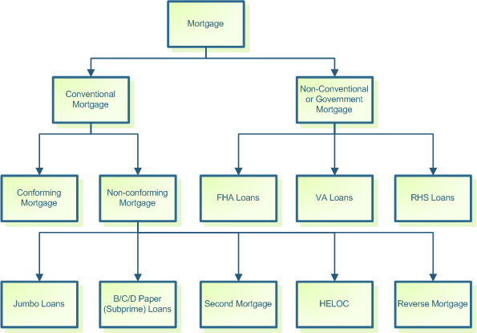
Types of Mortgages

Slide 50
Conventional Loans
By definition, a conventional loan is any mortgage that is not guaranteed or insured by the federal government. A conventional loan is generally referring to a mortgage loan that follows the guidelines of government sponsored enterprises (GSE's) like Fannie Mae or Freddie Mac.
To be eligible for an Conventional mortgage, borrower’s monthly housing costs (mortgage principal and interest, property taxes and insurance) must meet a specified percentage of your gross monthly income (28% ratio).
Borrower’s credit background will be fairly considered. At least a 620 FICO credit score is generally required to obtain a Conventional loan approval.
Borrower must also have enough income to pay your housing costs plus all additional monthly debt (36% ratio).

Slide 51
Conforming & Non-conforming Loans
Conventional loans may be either "conforming" and "non-conforming".
Conforming loans are such loans that follow the terms and conditions set by Fannie Mae and Freddie Mac.
Nonconforming loans are such loans that don't meet Fannie Mae or Freddie Mac guidelines, but they are also considered conventional.

Slide 52
Jumbo Loans or B/C/D Paper (Sub-prime) Loans
Loans above the maximum loan amount established by Fannie Mae and Freddie Mac are known as 'jumbo' loans. When FNMA and FHLMC limits don't cover the full loan amount, the loan is referred to as a "jumbo mortgage". The average interest rates on jumbo mortgages are typically higher than for conforming mortgages.
Loans that do not meet the borrower credit requirements of Fannie Mae and Freddie Mac are called 'B', 'C' and 'D' paper loans vs. 'A' paper conforming loans. B/C loans are offered to borrowers that may have recently filed for bankruptcy, foreclosure, or have had late payments on their credit reports. Their purpose is to offer temporary financing to these applicants until they can qualify for conforming "A" financing. The interest rates and programs vary, based upon many factors of the borrower's financial situation and credit history.

Slide 53
Second Mortgage / Home Equity Loan
Second and junior mortgages are any mortgage liens recorded behind the first mortgage lien. These types of loans are sometimes referred to as junior mortgages, because it is possible to have a third and additional mortgage lien―behind the actual second mortgage.
Second mortgages are often called home equity loans, since they are normally secured by the property's available equity.
A home equity loan is a mortgage loan that converts your property’s equity into cash.
For example, Adam’s home is worth $200,000. He currently has a mortgage of $120,000; this means that he has available equity of $80,000 ($200,000 - $120,000). If Adam is qualified, he can obtain a home equity loan of up to $80,000.

Slide 54
Use of Second Mortgage
Debt Consolidation – A consolidation loan combines several debts into one, usually lower payment. For example to consolidate the credit cards balances and save on the interest paid.
Home Improvement - Homeowners wishing to remodel their kitchens, build an addition or make any other (relatively) small improvements to their home find home equity loans and credit lines to be handy financing options.
Cash-Out for personal use - Similar to a cash-out refinances and the preceding cash-out for capital, many homeowners use home equity loans or credit lines to obtain cash-out for personal use.
Cash-Out for Investment - . A real estate investor can take out a home equity loan or credit line on a currently owned property, and then use those proceeds as down payment on another property.
Avoiding Mortgage Insurance - Home buyers may also use second mortgages to eliminate mortgage insurance.

Slide 55
Home Equity Line of Credit (HELOC)
The home equity line of credit is similar to the home equity loan. The primary difference is that the line of credit provides the borrower with a cheque book, instead of one lump-sum check.
The borrower can use the home equity credit line cheque book to withdraw funds for any purpose. The main advantage of the credit line is its flexibility and potential savings. The borrower can "disburse" loan funds as he or she needs them, and the borrower is only charged interest on the current balance.
The line of credit is a cross between a mortgage loan and a credit card.
For example, if Nora (in the preceding example) obtained a home equity line of credit for the $200,000, she can space out her withdrawals to fit her business needs and minimize interest charges. She can take out $50,000 now and perhaps $100,000 a couple of months later. She will only be charged interest on her current balance.

Slide 56
Reverse Mortgage
A reverse mortgage is a form of equity release (or lifetime mortgage) available in the United States. It enables eligible homeowners to access a portion of their equity. The homeowners can draw the mortgage principal in a lump sum, by receiving monthly payments over a specified term or over their (joint) lifetimes, as a revolving line of credit, or some combination thereof.
To qualify for a reverse mortgage in the United States, the borrower must be at least 62 years of age and must occupy the property as their principal residence.
As long as the borrower lives in and continues to own the home, the reverse mortgage loan will require no mortgage payment. The interest is charged and the unpaid interest is added to the principal balance.
If the borrower sells or moves out of the property, the loan will come due. In the case of a property sale, the sale proceeds will first be used to pay off the entire mortgage balance (as with any normal sale). Any profits left over will go to the borrower (seller).

Slide 57
Non-Conventional/ Govt. Loans
Non-conventional mortgage loans are basically government loans: VA (Veterans Affairs), FHA (Federal Housing Administration) and FmHA (Farm Housing Agency) — now RHS (Rural Housing Service) — loans.
Ginnie Mae, the Government National Mortgage Association, is the agency responsible for securitizing much of these non-conventional, government loans.
Contrary to what many people may believe, the VA and FHA normally do not fund loans.
These two governmental agencies only guarantee certain portions of a mortgage loan. But these are powerful and effective guarantees. These guarantees are reassuring to lenders in that they lower the lender's overall risk exposure.

Slide 58
VA – Veterans Affairs
The Veterans Affairs (VA) was created in 1930 to aid military veterans and current military personnel.
The VA loan soon followed to aid veterans and military personnel in finding affordable mortgage loans.
The VA office acts as a co-signer by guaranteeing a portion of the loan.
Standard banks and lenders will originate, fund and service the loan. When the borrower defaults, the VA will reimburse bank losses.
Most veterans and current members (both active and reserve) of the United States armed services are qualified for the loan. However, a minimum requirement of six full and continuous months of active duty must be satisfied.
The veteran applicant must present a copy of his or her DD Form 214, which is provided to the veteran when military service ends.
There is no down payment requirement for VA loans, unless the lender establishes one as a condition for the loan. Providing a down payment will often improve the conditions of the loan, so many borrowers do choose to pay some down payment.

Slide 59
FHA – Federal Housing Administration
The Federal Housing Administration (FHA) is an agency of the U.S. Department of Housing and Urban Development (HUD).
The National Housing Act of 1934 created the Federal Housing Administration (FHA), which was established primarily to increase home construction, reduce unemployment, and operate various loan insurance programs.
FHA does not make loans. Rather, it insures loans made by private lenders.
An FHA insured loan is a Federal Housing Administration mortgage insurance backed mortgage loan which is provided by a FHA-approved lender.
FHA insured loans are a type of federal assistance and have historically allowed lower income Americans to borrow money for the purchase of a home that they would not otherwise be able to afford.
To obtain mortgage insurance from the Federal Housing Administration, a mortgage insurance premium (MIP) equal to 1 percent of the loan amount at closing is required, and is normally financed by the lender and paid to FHA on the borrower's behalf.

Slide 60
RHS – Rural Housing Service
The Rural Housing Service (RHS) is an agency of the United States Department of Agriculture (USDA).
The Rural Housing Service (RHS) of the U.S. Dept. of Agriculture guarantees loans for rural residents with minimal closing costs and no down payment.
RHS administers direct loans, loan guarantees and grants. Direct loans are made and serviced by USDA staff; loan guarantees are made to banks or other private lenders, and grants are made directly to a person or organization.
RHS operates a broad range of programs to provide:
homeownership options to individuals; housing rehabilitation and preservation funding rental assistance to tenants of RHS-funded multi-family housing complexes; farm labour housing;
help to developers of multi-family housing projects, like assisted housing for the elderly and disabled, or apartment buildings community facilities, such as libraries, child care centres, schools, municipal buildings, and fire fighting equipment to Indian groups, non-profit organizations, communities and local governments.
Refer: http://www.rurdev.usda.gov/wy/rhs.htm for more information.

Slide 61
Loan Amortization

Slide 62
What is Amortization
Amortization is the process of decreasing, or accounting for, an amount over a period.
The paying off of debt in regular instalments over a period of time.
When used in the context of a home purchase, amortization is the process by which your loan principal decreases over the life of your loan.
With each mortgage payment that you make, a portion of your payment is applied towards reducing your principal and another portion of your payment is applied towards paying the interest on the loan.
An amortization table shows this ratio of principal and interest and demonstrates how your loan's principal amount decreases over time.

Slide 63
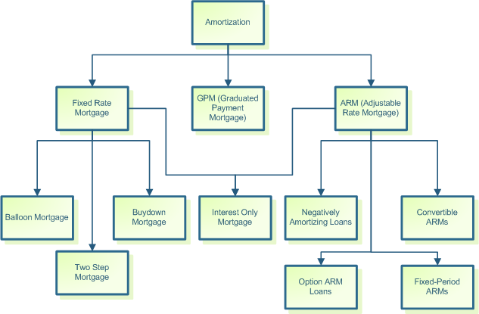
Types of Amortization

Slide 64
Fixed Rate Mortgage
With fixed rate mortgage (FRM) loan the interest rate and your mortgage monthly payments remain fixed for the period of the loan.
Fixed-rate mortgages are available for 40, 30, 25, 20, 15 years and 10 years. The most popular fixed mortgage terms are 30 and 15 years.
The payments on fixed rate fully amortizing loans are calculated so that at the end of the term the mortgage loan is paid in full.
During the early amortization period, a large percentage of the monthly payment is used for paying the interest. As the loan is paid down, more of the monthly payment is applied to principal.

Slide 65
Balloon Loans
Balloon loans are short-term fixed rate loans that have fixed monthly payments based usually upon a 30-year fully amortizing schedule and a lump sum payment at the end of its term. Usually they have terms of 3, 5, and 7 years. The 5-year and 7-year balloons are the standard balloon programs.
The payments are calculated as a 30-year loan; but at the end of the 5-year or 7-year term, the remaining balance must be paid off, refinanced or converted.
Balloon loans with refinancing option allow borrowers to convert the mortgage at the end of the balloon period to a fixed rate loan, based upon the outstanding principal balance, if certain conditions are met.
If Borrower refinance the loan at maturity he/she need not be prequalified, nor the property reapproved. The interest rate on the new loan is a current rate at the time of conversion. There might be a minimal processing fee to obtain the new loan.
The most popular terms are 5/25 Balloon, and 7/23 Balloon.

Slide 66
Two-Step Mortgage
A mortgage in which the borrower receives a below-market interest rate for a specified number of years (most often seven or 10), and then receives a new interest rate adjusted (within certain limits) to market conditions at that time.
The lender sometimes has the option to call the loan due with 30 days notice at the end of seven or 10 years.
Two-Step mortgages have a fixed rate for a certain time, most often 5 or 7 years, and then interest rate changes to a current market rate. After that adjustment the mortgage maintains new fixed rate for the remaining 23 or 25 years.
At the adjustment date, the borrower might have the option of choosing between a fixed-interest rate (based on current market rates) for the remaining term of the mortgage, or a variable interest rate structure for the remaining term of the mortgage.

Slide 67
Buy down Mortgage
A buy down is a mortgage financing technique where the buyer attempts to obtain a lower interest rate for at least the first few years of the mortgage
A mortgage buy down is essentially paying to have a lower interest rate. You will pay an upfront fee and in return get a lower rate on your loan. This lower rate is temporary however.
Borrower will take the current rate being offered, perhaps 5.5 percent, and then buy it down to 3.5 percent. The loan will be fixed at 5.5 percent for the entire thirty years, but the first year it will be at 3.5 percent, then the second year it will be 4.5 percent, and then the third year it will expand to the initial rate of 5.5 percent for the rest of the life of the loan.
The difference in the actual interest rate, and the lower rate, must be paid by the buyer or the seller at closing. So a lump sum will be paid and in exchange the buyer has a lower rate for a few years.
Buy down can be a permanent one or temporary one.

Slide 68
Interest Only Mortgage
An interest-only loan is a loan in which, for a set term, the borrower pays only the interest on the principal balance, with the principal balance unchanged. At the end of the interest-only term the borrower may enter an interest-only mortgage, pay the principal, or (with some lenders) convert the loan to a principal and interest payment (or amortized) loan at his/her option.
In the United States, a five- or ten-year interest-only period is typical. After this time, the principal balance is amortized for the remaining term. In other words, if a borrower had a thirty-year mortgage loan and the first ten years were interest only, at the end of the first ten years, the principal balance would be amortized for the remaining period of twenty years.

Slide 69
Graduated Payment Mortgage
A graduated payment mortgage loan, often referred to as GPM, is a mortgage with low initial monthly payments which gradually increase over a specified time frame.
These plans are mostly geared towards young men and women who cannot afford large payments now, but can realistically expect to do better financially in the future.
For instance a medical student who is just about to finish medical school might not have the financial capability to pay for a mortgage loan, but once he graduates, it is more than probable that he will be earning a high income.
It is a form of negative amortization loan.

Slide 70
Adjustable Rate Mortgage
Variable or adjustable loan is loan whose interest rate, and accordingly monthly payments, fluctuate over the period of the loan. With this type of mortgage, periodic adjustments based on changes in a defined index are made to the interest rate. The index for your particular loan is established at the time of application.
An adjustable-rate mortgage (ARM) allows the lender to change the interest rate—at periodic intervals—without altering other conditions of the loan agreement. When the interest rate is adjusted, the monthly principal & interest (P&I) payment is also readjusted.
When the lender adjusts the ARM loan's interest rate, they must do so according to the agreement set forth in the original promissory note signed at the closing. The standard method for adjusting ARM interest rate is to add the defined "margin" to the current "index" rate.
The margin is fixed percentage points added to the index to compute the interest rate.
It is the index that changes and underlies the ARM loan's adjustments. The interest rate on ARM loans is tied to the rates of securities, financial papers or a basket of indicators that adequately reflect market conditions. This indicator rate is normally called the index rate.

Slide 71
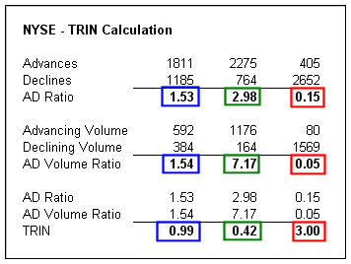
ARM Indexes
The benchmark interest rate to which an adjustable rate mortgage is tied. An adjustable rate mortgage's interest rate consists of an index value plus a margin.
The index underlying the adjustable rate mortgage is variable, while the margin is constant.
A technical analysis indicator that compares advancing and declining stock issues and trading volume as an indicator of overall market sentiment.
The Arms Index, or TRIN (Traders Index), is used as a predictor of future price movements in the market primarily on an intraday basis.
The Arms index is calculated as follows:
TRIN = (advancing issues/declining issues) (volume of advancing issues/volume of declining issues)
Advances: number of stocks in the index that closed up on the day
Declines: number of stocks in the index that closed down on the day
Up Volume: total volume of advancing stocks
Down Volume: total volume of declining stocks
(advances/declines) / (up volume/down volume)

Slide 72
ARM Continued
Well known ARM indexes include: -
Constant Maturity Treasury (CMT)
Treasury Bill (T-Bill)
12-Month Treasury Average (MTA or MAT)
Certificate of Deposit Index (CODI)
11th District Cost of Funds Index (COFI)
Cost of Savings Index (COSI)
London Inter Bank Offering Rates (LIBOR)
Certificates of Deposit (CD) Indexes
Bank Prime Loan (Prime Rate)
Fannie Mae's Required Net Yield (RNY)
National Average Contract Mortgage Rate
The most popular and commonly known are: -
11th District Cost of Funds Index (COFI) index
12-month Treasury average (MTA or MAT) indexes
London Interbank Offered Rate (LIBOR) indexes
Constant-maturity Treasury (CMT) indexes

Slide 73
ARM Continued
 | Rates adjust every | Term | Amortization
3-month | 3 months | 30 years | 30 years
6-month | 6 months | 30 years | 30 years
1-year | 1 year | 30 years | 30 years
3-year | 3 years | 30 years | 30 years
 | Rates adjust every | Term | Initial Amortization
3/1 | 1 year; after the 3rd year | 30 years | 30 years
5/1 | 1 year; after the 5th year | 30 years | 30 years
7/1 | 1 year; after the 7th year | 30 years | 30 years
10/1 | 1 year; after the 10th year | 30 years | 30 years
2-year/6-month | 6-month; after the 2nd year | 30 years | 30 years
As you can see from the above table, the ARM period does not affect the term and amortization. The ARM period merely indicates how often the loan's interest rates and consequently, its monthly payments are adjusted.
For example, a 3/1 ARM is basically a one-year ARM loan with one-year periods. However, for the first three years, the ARM loan's rate is fixed (will NOT adjust). After the third year, the ARM loan's rate will begin adjusting as normal.
The 2-year/6-month ARM is primarily used by non-conforming loan programs. The interest rate is fixed for the first two years; after that fixed period, the loan's interest rates begin adjusting every six months.

Slide 74
ARM Caps
Caps protect the borrower by limiting the movement of the interest rate, payments and principal balances, normally associated with ARM loans.
At the anniversary (one-year, six-month, etc., depending on period) of the ARM loan, the lender adjusts the interest rates and payments by adding the constant loan margin to the index rate.
However, this raw index-plus-margin number is not necessarily the borrower's new interest rate. This preliminary rate must be within the restrictions established by the specific loan program's caps. The new interest rate and monthly payment is the index plus margin, less whatever restrictions are required by the program's caps.
There are four types of caps that can be involved with each ARM loan:
Periodic Cap
Life Time Cap
Payment Cap
Principal Cap

Slide 75
Periodic Caps
The periodic cap limits how much the loan's interest rate may change from one period to the next. The norm for most conforming lenders is a periodic cap of one (1) or two (2) percentage points.
For example, if the loan program specifies a periodic cap of 2.00 percentage points, then the borrower's loan rate cannot increase (or decrease) by more than two (2) percentage points from one period to the next.
Thus, if the borrower had an interest rate of 6.50%, even if the index shot up to 19.00%, the most that the borrower's new rate can be is 8.50%.
Start rate: 6.50% Periodic cap: 2.00% Maximum 2nd year rate: 8.50%
A periodic or adjustment cap limits how much your interest rate can rise at one time.
The initial interest rate is 6%, the index is 5%, and the margin is 3%, then the new interest rate = 5% + 3% = 8%. If the periodic cap is 1% then the actual new interest rate will be 6% + 1% = 7%.

Slide 76
Life Time Caps
The lifetime cap establishes a maximum—and sometimes minimum—level that the interest rate may never surpass during the entire life of the loan. Most conforming loan programs set a lifetime cap of five (5) or six (6) percentage points, applied to the start rate.
For example, an ARM loan with a six (6) percent life cap and a starting rate of 5.50% would have a maximum limit of 11.50%. This means that even if the index would increase to 17.50% (which has happened in recent history), this ARM loan's interest rate would never exceed 11.50%.
For many ARM loans, the start rate is the lifetime "floor" cap. The loan's interest rate will never go below that start rate. Obviously, this is a great benefit for lenders when rates really drop.

Slide 77
Payment Caps
The payment cap limits how much the loan's monthly payment (not rate) may change from one period to the next.
The typical payment cap, if any, would be 7%-12% of the current payment. For example, if an ARM loan had a payment cap of 7% and a current mortgage payment of $100, the new payment would be a maximum of $107 per month ($100 * 1.07).
But payment caps do not limit the increases of interest rates. Consequently, payment caps may induce negative amortization, which means that the principal balance increases instead of decreases.
Check the ARM disclosure to be sure. Just because the payment increases are restricted does not mean that the interest calculated need not be paid.

Slide 78
Principal Caps
The principal cap often accompanies loans with payment caps, by placing a ceiling on negative amortization, so the principal amount increase will not exceed 125% of the original loan balance.
Starting loan amount: $200,000.00
Principal Cap: 120%
Maximum loan amount (with Negative Amortization): $240,000.00

Slide 79
Negative Amortization Mortgage
Negative amortization occurs whenever the monthly payments are not enough to cover the interest due on the debt. Unless the loan explicitly waives this unpaid interest, that deficit amount is added to the principal balance.
This unfavorable situation is a regular byproduct of ARM loans with payment caps. Often, the payment caps so limit the payment adjustment that the new payment calculation is not enough to cover the interest due on the loan. Worse yet, as unpaid interest is added to the principal balance, the borrower will be charged interest on the unpaid interest.
Because this situation could lead to endlessly increasing principal balances, ARM loans with payment caps usually also contain principal caps, as a protection against negative amortization. Principal caps still allow negative amortization to increase the principal balance, but sets limits on how high the principal may increase.
Most principal caps limit negative amortization increases to 125% of the original loan balance. Thus, an ARM loan with negative amortization and an original balance of $100,000, can have its principal increase to $125,000. Any unpaid interest after that limit is reached is usually waived by the lender.

Slide 80
Fixed Period ARMs
With fixed-period ARMs homeowners can enjoy from three to ten years of fixed payments before the initial interest rate change. At the end of the fixed period, the interest rate will adjust annually.
Fixed-period ARMs -- 30/3/1, 30/5/1, 30/7/1 and 30/10/1 -- are generally tied to the one-year Treasury securities index.
ARMs with an initial fixed period beside of lifetime and adjustment caps usually have also first adjustment cap. It limits the interest rate you will pay the first time your rate is adjusted. First adjustment caps vary with type of loan program.
The advantage of these loans is that the interest rate is lower than for a 30-year fixed (the lender is not locked in for as long so their risk is lower and they can charge less) but you still get the advantage of a fixed rate for a period of time.

Slide 81
Convertible ARMs
Some ARMs come with option to convert them to a fixed-rate mortgage at designated times (usually during the first five years on the adjustment date), if you see interest rates starting to rise. The new rate is established at the current market rate for fixed-rate mortgages.
The conversion is typically done for a nominal fee and requires almost no paperwork. The disadvantage is that the conversion interest rate is typically a little higher than the market rate at that time.
The other kind of convertible mortgage is a fixed rate loan with rate reduction option. If rates had dropped since the time of closing it allows you, under some prescribed conditions, for a small conversion fee to adjust your mortgage to going market rate.
Generally the interest rate or discount points may be a little higher for a convertible loan.

Slide 82
Option ARMs
This loan program is an adjustable rate mortgage with added flexibility of making one of several possible payments on your mortgage every month, in order to better manage your monthly cash flow. It's low introductory start rate allows you to make very low initial mortgage payments and low qualifying rates enable you to qualify for more home.
The minimum payment option can help keep your monthly payments affordable. If the minimum monthly payment is not sufficient to pay the monthly interest due, you can always avoid deferred interest by choosing the interest-only payment option.
With the Option ARM, you generally have at least two fully amortized payment choices, leading to a quicker loan payoff. If you prefer to pay off your loan on schedule, you can make the fully amortized payment based on a 30-year loan, or you can choose the 15-year payment option for the fastest equity build-up.

Slide 83
Loan Purpose

Slide 84
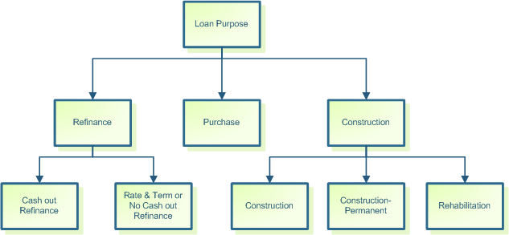
Loan Purpose

Slide 85
Purchase Loans
A purchase loan is used to buy an existing property, whether that property is merely an empty lot or a developed land with an already finished building. As the name indicates, the purchase loan requires a transfer of the property's ownership from the seller to a buyer.
Purchase loans typically allow higher LTV ratios, which translate into lower down payment requirements—as compared to refinance and most construction loan programs.
For example, conforming fixed-rate loans allow LTV ratios of up to 97% (even 100%) LTV financing on home purchases, for a minimum down payment requirement of 3% (or 0%). However, the same conforming programs, when used for a refinance, lower their maximum LTV ratio level to only 95% (or lower)—so the borrower must show existing equity after refinance closing of at least 5%.

Slide 86
Refinance Loans
Mortgage refinances refer to the replacement of an existing mortgage loan with another mortgage loan. The old loan is paid and closed with the proceeds of the new loan. Moreover, this new mortgage loan also may be used to pay off other liabilities and debts that the borrower has incurred or plans to incur.
Note that with this definition, home equity loans and other types of second mortgages are essentially refinance loans. The only difference between a first and second mortgage is their lien position against the property; and the lien position determines who gets paid first in case of a sale or foreclosure .
An advantageous feature of most refinance loans is that they allow the borrower to finance closing costs, which is not allowed with most conventional loans. This allows the borrower to avoid spending personal funds to pay closing costs.
Refinance loans are further divided into two categories:
No Cash Out or Rate & Term Refinance or Debt Consolidation
Cash Out Refinance
Most refinance loans are used for at least one of the following four reasons:
Better Interest Rate
Change of Term
Consolidation of Debt
Extra Cash

Slide 87
Refinance Types
Rate & term refinance
The first refinance type is often called a "rate & term" or "no cash-out" refinance. As those titles imply, this type of refinance merely replaces an existing loan with a new loan—while not cashing out any of the existing equity for non-mortgage use. This refinance loan does allow the borrower to refinance at a higher loan amount in order to pay closing costs, and consolidate other debts thereby effectively financing those costs and pay off other debts that are consolidated.
Cash-out refinance
The cash-out refinance is normally any refinance that converts the property's existing equity into cash. If a property owner owed nothing on his or her property and then obtains any financing that cashed some or all of the property's equity, that financing would be considered a cash-out.
Most cash-out refinances tend to replace existing mortgage liens with a larger loan amount, allowing for additional cash back to the borrower.

Slide 88
Construction Loans
Home buyers who wish to build a completely new home, as well as homeowners who wish to rehab their properties, need construction loans.
With construction loans, the lender is essentially lending money for something that does not yet exist. Hence, there are more restrictions on the construction loan, so as to ensure that the property will be built according to approved plans and specifications.
Construction financing programs typically fall into three categories, which affect their structure and pricing:
Construction
Construction-Permanent
Rehabilitation

Slide 89
Construction Loan Types
Construction
Construction loans are used to finance the actual construction of the property. Construction loans are normally short-term loans that must be paid off or refinanced immediately after the construction is completed.
Construction-Permanent
Construction-permanent loans are such construction loans that automatically convert into a permanent loan upon completion of the building. Construction loans are to be paid off or refinanced after the construction is completed, but the Construction-Permanent loans get automatically converted to full permanent loans.
Rehabilitation
Rehab loans are more complicated.
In most cases, they are often second mortgages that provides the homeowner with extra cash to make improvements or additions to the home.
A portion of the Rehab loan proceeds are used to pay off the existing mortgage, and the remaining funds are placed in an escrow account and released as rehabilitation is completed.
For Example Section 203k mortgage (FHA Loans)

Slide 90

A LOOK AT THE UNIFORM RESIDENTIAL LOAN APPLICATION A.K.A. FORM 1003

Slide 91

What’s Needed on a Loan Application?
Borrower’s personal information such as name, social security number, age, etc.,
Property Information
2 years address history
2 years employment history
Income information
Debt information
Declarations
Acknowledgement & Agreement
Govt. Monitoring Information

Slide 92
Let’s take a look at the entire document

Slide 93

I. Type of Mortgage & Terms
Type of Mortgage
Terms of Loan
Interest Rate
Number of Mos. Amortized
Amortization Type

Slide 94
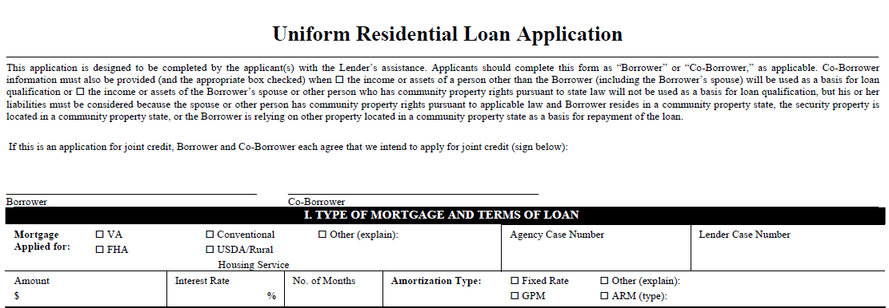

Slide 95
II. Property Info & Purpose Of Loan
Subject Address
Legal Description
Number of Units
Year Built
Purpose of Loan
Property Type
Construction/Refinance
Improvements
Title
Source of Funds
Estate

Slide 96
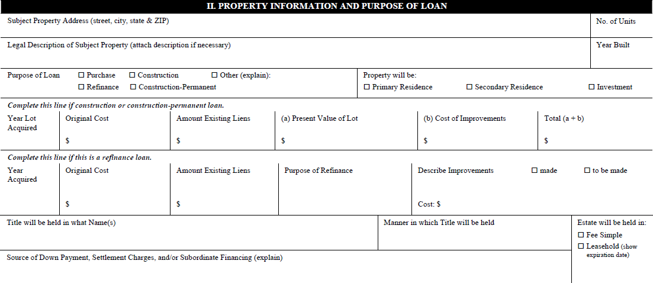

Slide 97
III. Borrower Information
Name
Age
Social Security #
Phone
Yrs. In School
Marital Status
Dependents Info
Address Info
Own/Rent
Yrs. @ Current Address
Previous Address Info
Co-borrower Info

Slide 98
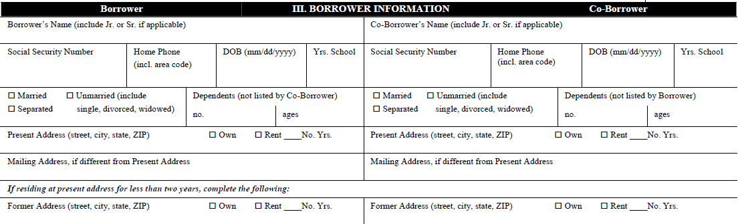

Slide 99
IV. Employment Information
Employer Name & Address
Yrs. On Job
Yrs./Line of Work
Position/Title/Type of Business
Phone
Previous Employer
Dates To-From
Monthly Income
Co-Borrower Employment Info

Slide 100
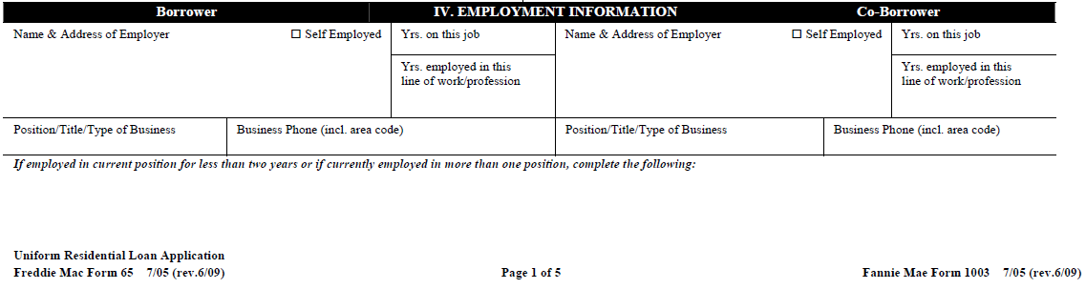

Slide 101
V. Income & Combined Expense
Base Income
OT/Bonus/Comm.
Dividends/Interest
Rental
Other Income
Combined Monthly Housing Expense
Present Rent/Mtg.
Other financing
Insurance/Taxes/MI
HOA
Other Expenses
Total
Proposed

Slide 102
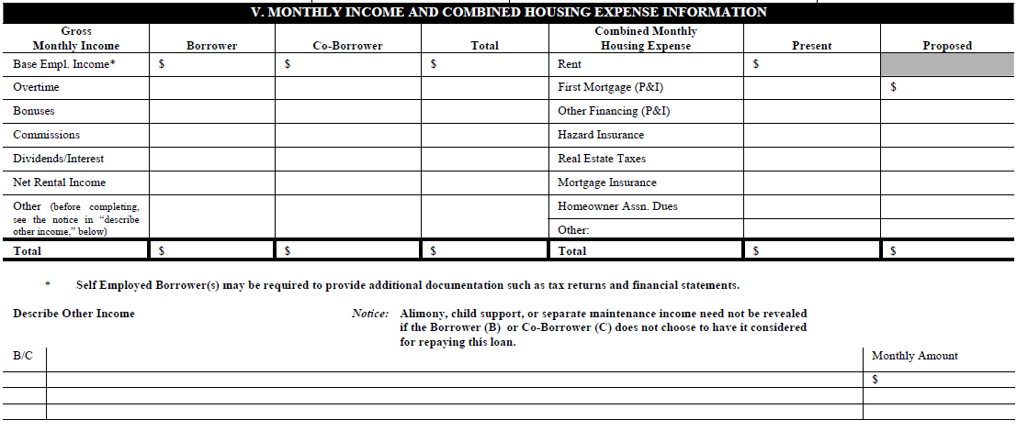

Slide 103
VI. Assets & Liabilities
List of ALL Accounts in Assets & Liabilities
Account Numbers
Account Balance
Name & Address of Institution
Monthly Payments and Months Left to Pay
Unpaid Balances

Slide 104
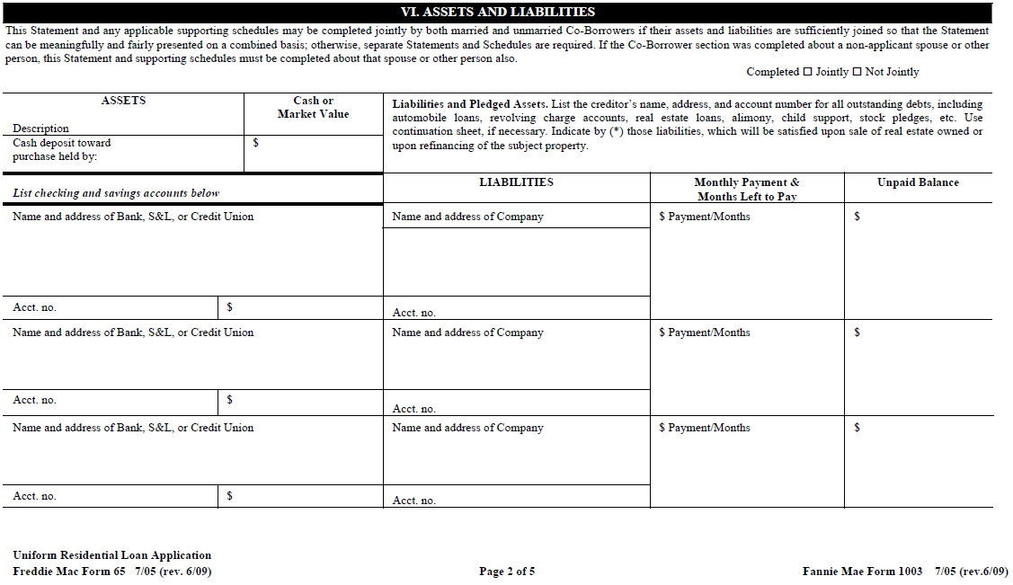

Slide 105
VII. Details of Transaction
Be Accurate !
Validate Your Good Faith Estimate (GFE) w/Your Vendors !
Check Your Numbers !
Get Help If You Need It !

Slide 106
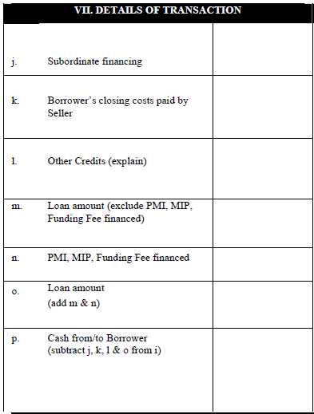
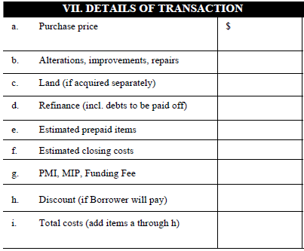

Slide 107
VIII. Declarations
A list of questions that has to be answered by each borrowers applying for loan.
Loan officer has to Check this information against the credit report and title report.
Loan Officer has to Work with the underwriter and borrower to get issues resolved.

Slide 108
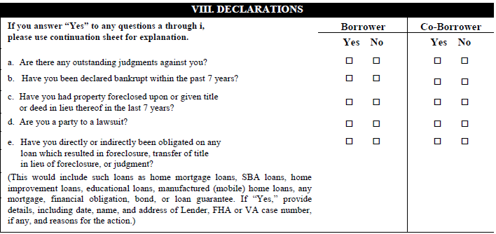

Slide 109
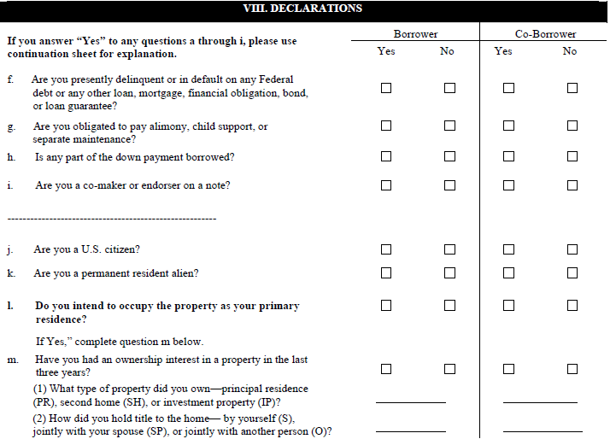

Slide 110

IX. Acknowledgement & Agreement
If LO takes the application in person, the customers may sign it at that time.
If LO take the application over the phone, the customers must sign both the handwritten application and the typed application.

Slide 111
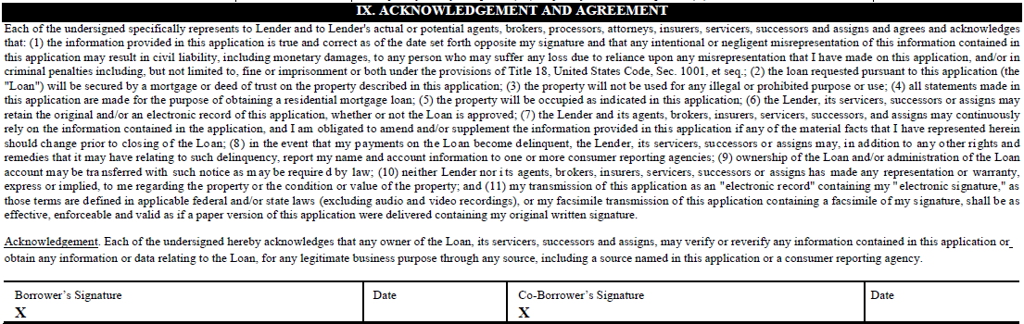

Slide 112

Why is it important that the borrowers AND the Loan Officer sign the application?
????

Slide 113

Because…..
The signatures ATTEST to the fact that the information provided on the application is true and correct as well as HOW the application was taken (phone, in-person or mail)

Slide 114
X. Government Monitoring Information
Loan Officer must complete this portion even if the borrowers do not want to disclose !! The Home Mortgage Disclosure Act (HMDA) requires that all applicants disclose this info or the Loan Officer must disclose to the best of his/her ability !!!

Slide 115
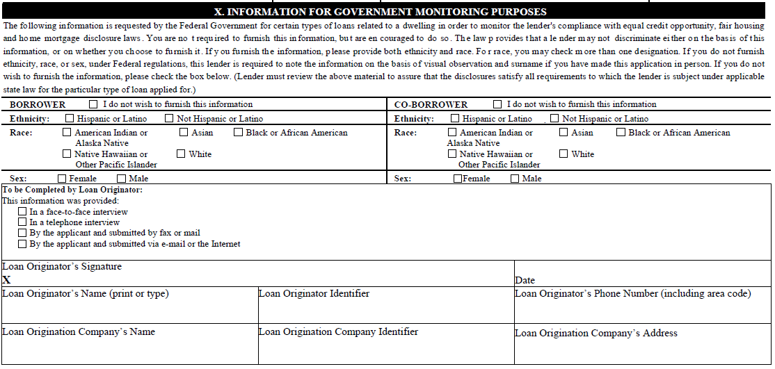

Slide 116

Mortgage Maths

Slide 117

Calculating Income
Hourly, Full Time or Part Time
Salaried, Weekly or Bi-weekly
Commissioned
Bonus
Overtime
Self Employed
Retirement
Rental
Dividends/Interest

Slide 118
Hourly Income
$9.00 Gross Hourly Wage
40 Average Hours, Paid Weekly
$9.00 X 40 Hours = $360.00 X 52 Weeks = $18,720/12 =
$1,560.00 Gross Monthly Income

Slide 119
Hourly Income, Part Time
Borrowers with part time income should have 24 months employment
$15.00 X 23 Hours = $345.00 X 104 Weeks = $35,880 / 24 = $1,495.00
Gross Monthly Income = $1,495.00

Slide 120
Salaried Income
$825.00 weekly, salaried gross paycheck
$825.00 weekly gross X 52 weeks = $42,900/12 = $3,575.00
Gross Monthly Income = $3,575.00
$1,361.00 bi-weekly, salaried gross paycheck
$1,361.00 weekly gross X 26 weeks = $35,386.00/12 = $2,948.83
Gross Monthly Income = $2,948.83

Slide 121
Overtime Income
Your customer should have 24 months of overtime income for the income to be acceptable !
You should review W-2 Forms and Paystubs to calculate the average overtime income !
$18,720.00 base salary
W-2 indicates $26,435.00
$26,435.00 W-2 Statement - $18,720.00 base salary =
$7,715.00/12 = $642.92 average monthly overtime amount

Slide 122
Commissioned Income
Base Salary = $25,000.00
2004 W-2 = $66,720.00
2005 W-2 = $68,671.00
$66,720.00 - 2004 W-2 = $25,000.00 base salary = $41,720.00 commission for 2004
$68,671.00 - 2005 W-2 = $25,000.00 base salary = $43,671.00 commission for 2005
$41,720.00 (2004) + $43,671.00 (2005) = $85,391.00/24 months = $3,557.96 average monthly commission income.

Slide 123
Bonus Income
Calculating bonus income is virtually the same as calculating commission income. You must take a 24 month average and divide in order to receive a monthly bonus amount.
Additionally, a Verification of Employment should accompany any W-2s and paystubs indicating the likelihood of continued bonus amounts.

Slide 124
Retirement Income
For borrowers with retirement income, you are able to gross it up by 1.25% (if amount is NOT taxed).
For pensions, you will need to obtain award letters or copy of bank statements.
You should check with specific lender guidelines for how many months bank statements will be required.

Slide 125
Rental Income
On the Schedule E portion of the tax return, you will find the gross rental receipts.
You must multiply this by 75% LESS the current mortgage payment and divide by 12 to get the monthly rental income
$10,800.00 gross rental receipts
$5,400.00 yearly mortgage payments
$10,800.00 gross rental receipts X 75% = $8,100.00 - $5,400.00 annual mortgage payments = $2,700.00/12 = $225.00 monthly rental income

Slide 126
Dividend/Interest Income
If a borrower has dividends or interest income, you may use the actual amount of income received.
It is common for a lender to require at least 12 months of bank statements showing regular monthly deposits from a financial institution.

Slide 127
Ratios in Mortgage

Slide 128
Loan-to-Value Ratio (LTV)
The Loan-to-Value ratio is a percentage that refers to the amount of the loan divided by either the property's Appraised Value or current Purchase Price whichever is less.
The inverse of the LTV ratio on a purchase loan is the down payment.
For example, if the lender's LTV ratio on a particular loan is 90%, then the borrower must come up with the remaining 10% as the down payment.
To Calculate LTV ratio: Divide the loan amount by the purchase price or appraised value whichever is lower.
Example:
$90,000 loan amount/ $100,000 purchase price = 90% LTV

Slide 129
Cumulative/Combined Loan To Value (CLTV)
Cumulative Loan To Value (CLTV) is calculated when there is a 2nd mortgage or other financing in addition to the first.
One reason why a borrower may want a 2nd mortgage or other financing for a purchase transaction is to avoid mortgage insurance.
EXAMPLE:
$200,000.00 purchase price
$160,000.00 first mortgage
+ 20,000.00 second mortgage
=180,000.00 cumulative liens
$160,000.00 (80%) + $20,000.00 (10%) = $180,000.00 / $200,000.00 purchase price = 90% CLTV

Slide 130
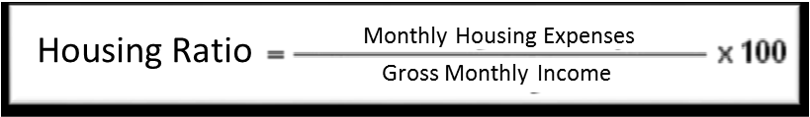
Housing Ratio
The housing ratio is also known as the front-end ratio. It is calculated using the following formula:
Items that are included in the Monthly Housing Expense are:
Mortgage Loan Payments of Principal & Interest = P & I
Real Estate Taxes = T
Hazard Insurance = I
Homeowners Association Dues/ if applicable = HOA
Mortgage Insurance = MI
Flood Insurance/if applicable = I
Monthly Housing Expense = PITI

Slide 131
Example…
$ 4,350.00 Borrower’s Gross Monthly Income
$ 900.00 Principal & Interest Payment
$ 125.00 Real Estate Taxes
$ 55.00 Homeowners Insurance
$ 60.00 Mortgage Insurance
$ 10.00 HOA Dues
$ 1,150.00 Total Monthly Payment
$1,150.00 / $4,350.00 = 26% Housing Ratio (a.k.a. front end ratio)

Slide 132
Total Debt Ratio
Indicates the percentage of income that goes toward paying all recurring debt payments, such as credit card payments, car loan payments, student loan payments, child support payments, alimony payments, and legal judgments.
This is Also Known As The Back-End Ratio. It is calculated using the following formula:
The total debt ratio consists of:
Housing Payment (PITI)
Monthly Car Payments (if applicable)
Monthly Minimum Credit Card Payments (if applicable)
Monthly Student Loan Payments (if applicable)
Any Other Monthly Debt

Slide 133
Example…
$ 4,350.00 Borrower’s Gross Monthly Income
$ 1,150.00 Total Housing Expense (PITI)
$ 550.00 Car Payment
$ 135.00 Student Loan Payment
$ 25.00 Credit Card Payment
$ 15.00 Credit Card Payment #2
$ 1,875.00 Total Debts
$1,875.00 / $4,350.00 gross monthly income = 43% total debt ratio

Slide 134

Supporting Documentation

Slide 135

What’s Included In A Loan File?
Loan Application (URLA/1003)
Credit Report
Income Verification
Verifications of Deposit
Mortgage/Rent Verification
Appraisal
Title Binder/Commitment
Purchase Agreement

Slide 136
Credit Report
A consumer credit report is a factual record of an individual’s payment history as reported by his/her creditors.
A credit report provides a snapshot of your credit accounts, repayment record and how well you are coping with your finances.
Credit reports are most frequently used to help lenders quickly and objectively decide whether to grant credit to an applicant.
The credit report is used to assess the borrower’s willingness to meet his or her debt obligations. Seven years of credit history is generally considered adequate.
Payment history, whether derogatory or good, provides a picture of the borrower’s payment character.
Underwriters place heavy emphasis on paying habits as a key indicator of whether the borrower is a high or low risk.

Slide 137
Credit Report Includes…
Subject’s name (borrower)
Social Security Number
Spouse’s Name
Current Address and Length of time at address
Present Employer and Position
Salary
Length of Employment
Date of Birth
Number of Dependents
Whether Subject owns or rents at current address
Previous Employer
Previous Addresses
Late payments
Recent inquiries
Listing of all accounts known to the bureau, including terms, balances, payment ratings, and account holder designation.
A list of public records, such as suits, judgments, foreclosures, bankruptcies, Divorce

Slide 138

Types of Credit Reports
Single Bureau Credit Reports
3 Bureau Credit Reports

Slide 139
Single Bureau Credit Reports
A single bureau credit report provides your credit information from only one of the three major credit bureaus (an Experian credit report, Equifax credit report, or Trans Union credit report).
Technically, the three major credit bureaus are supposed to house the same credit report information, but they don't always.
Therefore, it's possible that the credit report you choose to order only provides 1/3 of your whole credit picture.
For a complete picture of your credit history, your best bet is to order a three bureau credit report.

Slide 140
3 Bureau Credit Reports
A 3 bureau online credit report provides your credit from all three major credit bureaus, Experian, Equifax and Trans Union.
The 3 bureau credit report lists all of borrower credit accounts, line-by-line, bureau by bureau, which allows you to see everything that's being reported about your credit and your financial history.
Larger banks usually report credit information to all three major credit bureaus, but smaller banks and other lenders may report your credit information to only one.
Therefore, as discussed in the previous slide, the credit report at one bureau won't necessarily match your credit report at another.
For the most complete picture of your credit history, a 3 bureau credit report is your smartest option.
A 3 bureau credit report will paint a clear picture of all your files so you no longer have any doubts regarding your credit history.

Slide 141
Credit reports used by mortgage companies are typically tri-merge reports which include information from all 3 major credit reporting bureaus

Slide 142
What is a Credit Score?
A credit score is a number that summarizes the borrower’s credit risk, based on a snapshot of his/her credit report at a particular point of time.
Credit scores range from 300 to 900, with the majority of scores falling in the range of 500 to 750. The general scoring range is 350-850.
A credit score helps lenders to evaluate borrower’s credit risk.
The most widely used credit scores are FICO Scores, the credit scores created by FICO.

Slide 143
Credit Score Risk Categories
Fair Isaac divides the scoring range into five risk categories:
780-850 Low Risk
740-780 Medium-Low Risk
690-740 Medium Risk
620-690 Medium-High Risk
620 and Below High Risk or "sub-prime"

Slide 144
FICO Scores
Credit Reporting Agency | FICO Score Name
Equifax | BEACON Score
Experian | Experian / FICO Risk Model
TransUnion | EMPIRICA

Slide 145
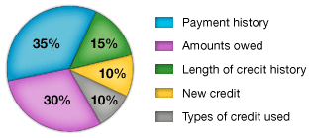
Components of FICO Scores
FICO Scores are calculated from a lot of different credit data in your credit report. This data can be grouped into five categories as outlined below. The percentages in the chart reflect how important each of the categories is in determining your FICO score.
These percentages are based on the importance of the five categories for the general population.
http://www.myfico.com/crediteducation/creditscores.aspx

Slide 146
FICO Components – Payment History
Account payment information on specific types of accounts (credit cards, retail accounts, instalment loans, finance company accounts, mortgage, etc.)
Presence of adverse public records (bankruptcy, judgements, suits, liens, wage attachments, etc.), collection items, and/or delinquency (past due items)
Severity of delinquency (how long past due)
Amount past due on delinquent accounts or collection items
Time since (recency of) past due items (delinquency), adverse public records (if any), or collection items (if any)
Number of past due items on file
Number of accounts paid as agreed

Slide 147
FICO Components – Amounts Owed
Amount owing on accounts
Amount owing on specific types of accounts
Lack of a specific type of balance, in some cases
Number of accounts with balances
Proportion of credit lines used (proportion of balances to total credit limits on certain types of revolving accounts)
Proportion of instalment loan amounts still owing (proportion of balance to original loan amount on certain types of instalment loans)

Slide 148
FICO Components – Length of Credit History
Time since accounts opened
Time since accounts opened, by specific type of account
Time since account activity

Slide 149
FICO Components – Types of Credit Used
Number of (presence, prevalence, and recent information on) various types of accounts.
Credit Cards
Retail Accounts
Instalment Loans
Mortgage
Consumer Finance Accounts
Etc.,

Slide 150
FICO Components – New Credit
Number of recently opened accounts, and proportion of accounts that are recently opened, by type of account
Number of recent credit inquiries
Time since recent account opening(s), by type of account
Time since credit inquiry(s)
Re-establishment of positive credit history following past payment problems

Slide 151
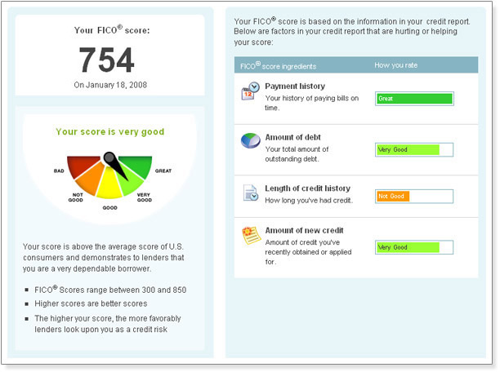

Slide 152
What’s in the Credit Report
Although each credit reporting agency formats and reports this information differently, all credit reports contain basically the same categories of information. Your social security number, date of birth and employment information are used to identify you. These factors are not used in credit scoring. Updates to this information come from information you supply to lenders.
Identifying Information
Trade Lines
Credit Inquiries
Public Records and Collection Items.

Slide 153
Identifying Information
Your name, address, Social Security number, date of birth and employment information are used to identify you.
These factors are not used in credit scoring.
Updates to this information come from information you supply to lenders.

Slide 154
Trade Lines
These are your credit accounts.
Lenders report on each account you have established with them.
They report: -
The type of account (bankcard, auto loan, mortgage, etc.,)
The date you opened the account
Your credit limit or loan amount
The account balance
Your payment history

Slide 155
Credit Inquiries
Credit inquiries are records created when someone looks at your credit information. Credit inquiries are either "hard inquiries," as when a business views your credit report in connection with an application for credit, or "soft inquiries" when your credit is checked for most other reasons.
When you submit a credit card application, a hard credit inquiry appears on your credit report and may have an effect on your credit. When you monitor your own credit report, or when someone checks it to make you a pre-approved credit offer, that creates a soft inquiry that is not seen by others, and will not have any impact on your credit score.
When you apply for a loan, you authorize your lender to ask for a copy of your credit report. This is how inquiries appear on your credit report.
The inquiries section contains a list of everyone who accessed your credit report within the last two years.
The report you see lists both "voluntary" inquiries, spurred by your own requests for credit, and "involuntary" inquires, such as when lenders order your report so as to make you a pre-approved credit offer in the mail.

Slide 156
Public Records & Collection Items
Credit reporting agencies also collect public record information from state and county courts, and information on overdue debt from collection agencies.
Public record information includes: -
Bankruptcies
Foreclosures
Suits
Wage attachments
Liens
Judgments

Slide 157
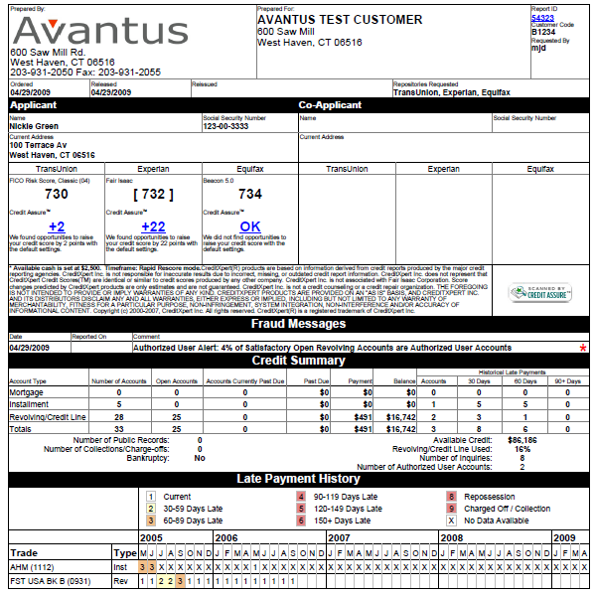
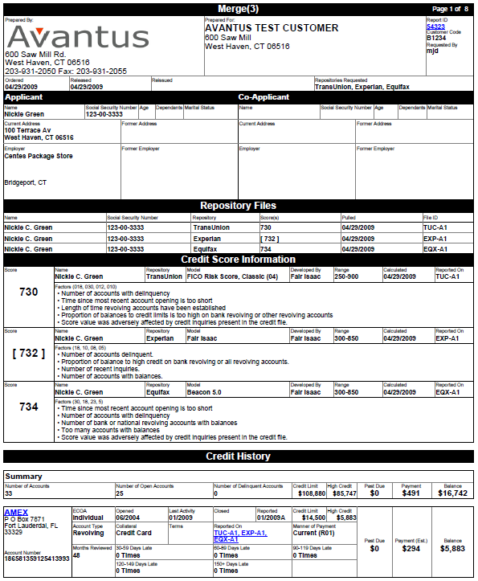

Slide 158
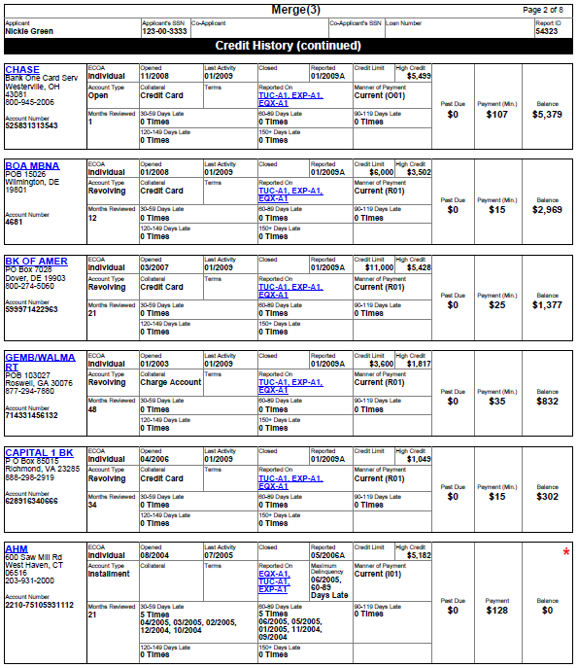
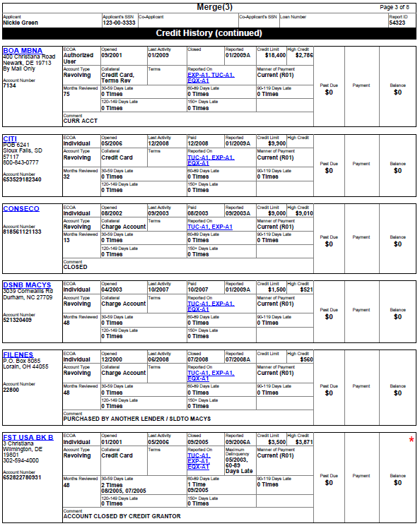

Slide 159
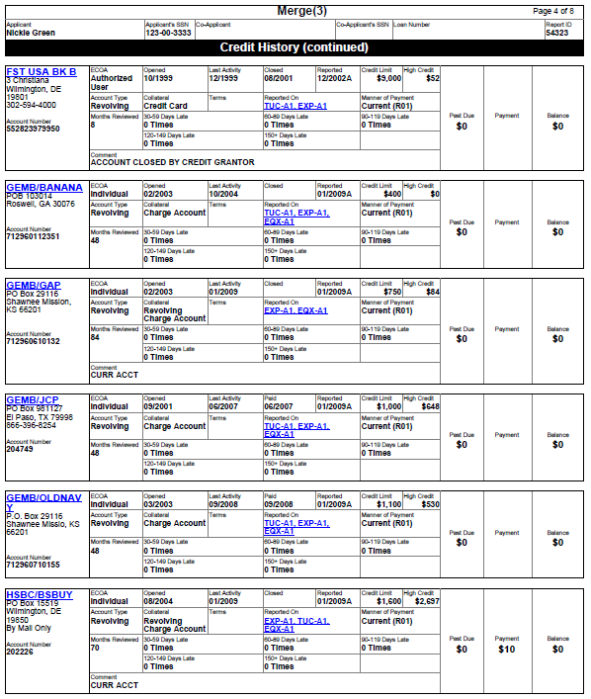
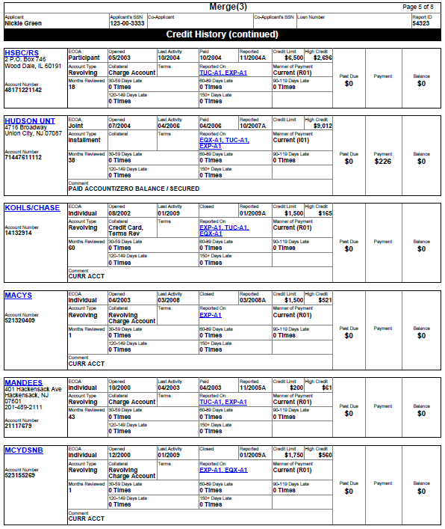

Slide 160
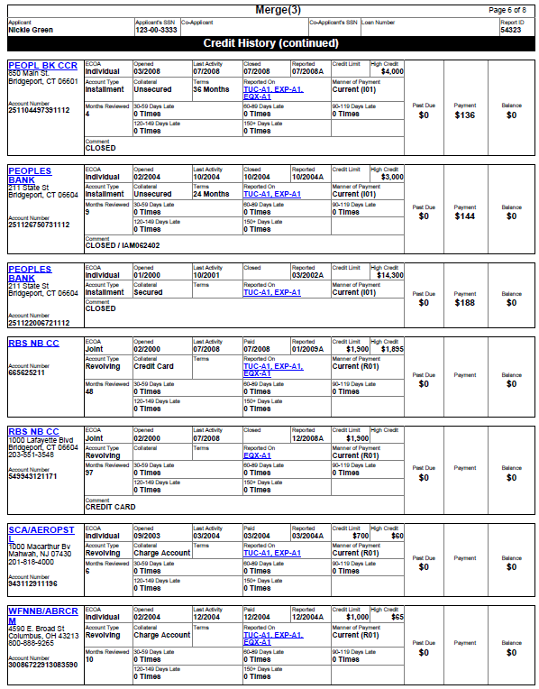
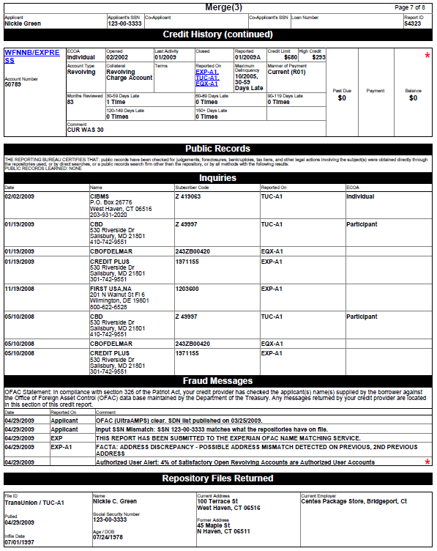

Slide 161
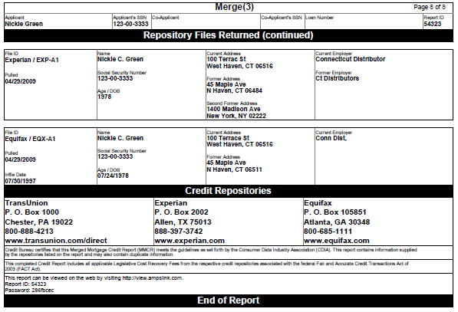
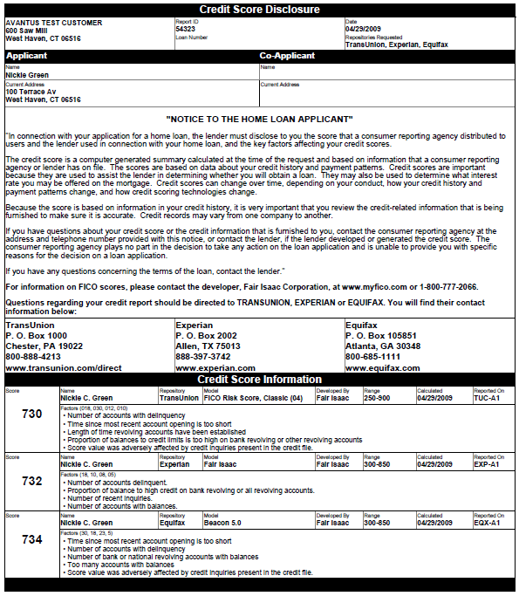

Slide 162
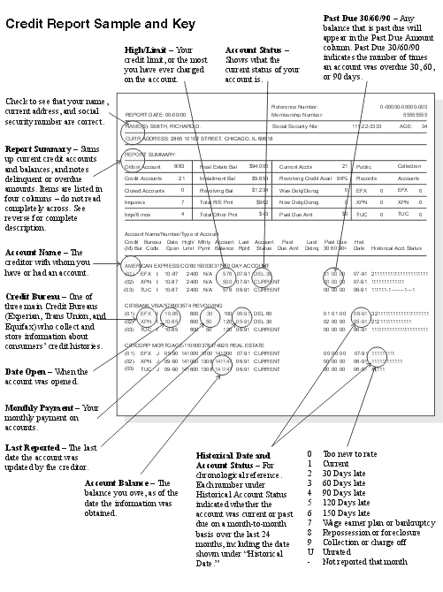

Slide 163
Independent Verifications
Independent verifications of information given by the borrower on the Loan Application are required.
They support the borrower’s ability and willingness to meet his or her loan obligation.
Verifications will establish the exact amount of income and assets, and the credit report and mortgage or rent verification detail the borrower’s financial obligations.

Slide 164
The standard verifications are:
Verification of Employment (VOE)
Verification of Deposit (VOD)
Gift Letter
Verification of Rent or Mortgage (VOR or VOM)

Slide 165

Verification of Employment (VOE)
The VOE form is used to confirm the borrower’s employment and income.
This form should be sent directly to the borrower’s employer to the attention of the Human Resources or Personnel Department.
If the VOE does not cover the past two years, the borrower’s previous employment must also be verified.

Slide 166
Salary/Wage Earner/Part Time/2nd Job
Paystubs covering the most recent 30 days
2 years W-2 Statements
Verbal or Written Verification of Employment (VOE)
Confirmation of at least 2 years job history

Slide 167
Overtime/Commission/Bonus
Paystubs covering the most recent 30 days
2 years W-2 Statements
Verbal or Written Verification of Employment, including the likelihood of continuance
Confirmation of at least 2 years job history

Slide 168
Self-Employment
2 years most recent signed tax returns (personal and/or business, depending on lender guidelines
Year-to-date Profit & Loss statement
Current or past year’s business license(s)
Recent advertisement of the business or brochure/pamphlet
Signed letter from borrower’s Accountant verifying status of the business

Slide 169
Fixed Income – Social Security, Disability
Most recent award letter from issuing agency
2 or 3 months most recent bank statements showing regular deposits directly from the issuing agency

Slide 170
Rental Income
2 years most recent signed tax returns with all schedules specifically Schedule E
Signed lease, if applicable
Note – specific loan programs and underwriting guidelines will determine additional documentation needed

Slide 171
Verification of Deposit (VOD)
The Verification of Deposit form is used to confirm the balances in the borrower’s checking and savings accounts as well as balances, payment amount, and paying history on outstanding loans.
The borrower must have sufficient funds for the down payment, closing costs and other expenses, and reserves for mortgage payments.
The loan processor should complete part I of a VOD for each depository at which the borrower has accounts.

Slide 172
Verification of Rent/Mortgage (VOR/M)
The VOR/VOM form is used to verify the borrower’s current mortgage payment history or rental payment history.
The VOR/VOM form should be mailed to the borrower’s landlord or mortgagee.
Check to be sure that the person completing Part II of the form has signed and dated it.

Slide 173
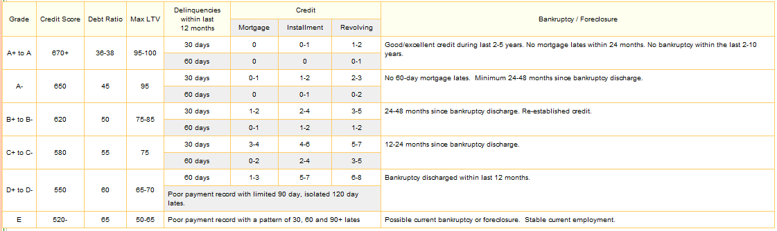
A Summarized Look

Slide 174
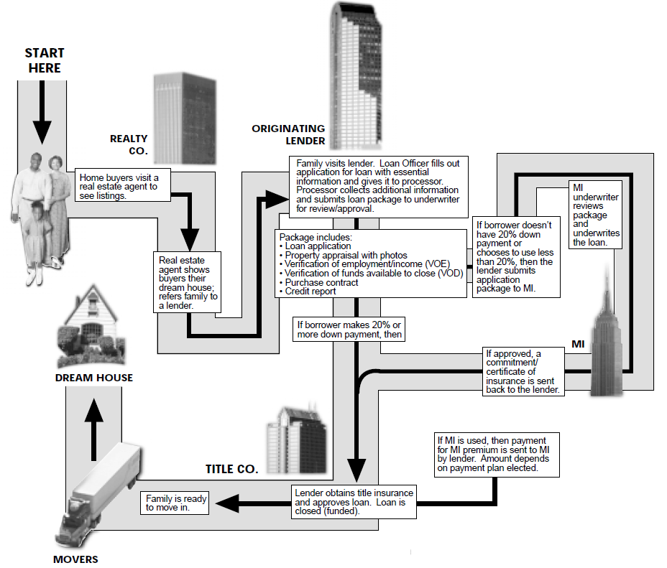

Slide 175
Questions?

Slide 176

Congratulations! You Have Completed the Training on Introduction to Mortgage Lending…

Slide 177
Thank You

